Slide 1
Take-Out System Features, Compact Version
TAKE-OUT SYSTEM FEATURES
Warranty - 12 months for refurbished and new Gearboxes
Made by the original Swiss Gearbox manufacturer. Well known high quality & long lifetime No compromises and no risks regarding quality and durability. SETO Version 1 is since 2003 under glass.
Same backlash as on a new Gearbox (10 arcmin max.) Worm gear is precisely aligned to worm shaft at assembly for low backlash & very long durability
New front cover with extra strong end stops
SETO Version 1 can be repaired an unlimited number of times cheaply
Zero backlash operation: Excellent repeatability and positional accuracy even at high speed operation. Reduces vibration of Tong Head
Fool-proof design. No adjustments at assembly or maintenance. No risk to overload angular bearings
Improved precision of Tong Head angular position adjustment when used on SETO Gear Box
Fully covered roller bearings. Sealed for life.
Actively cooled Arm with the seals, the timing belt and the lubricating grease in the bearings
Modular design, most parts are identical on all Take Out Arm versions and sizes. Minimized number of different spare parts.

Slide 2
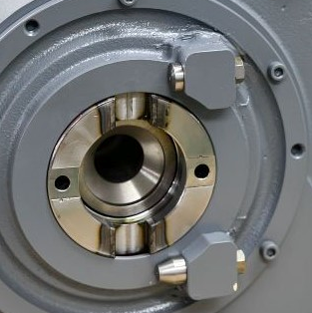
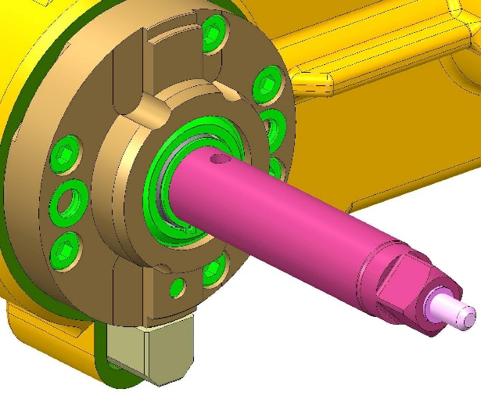
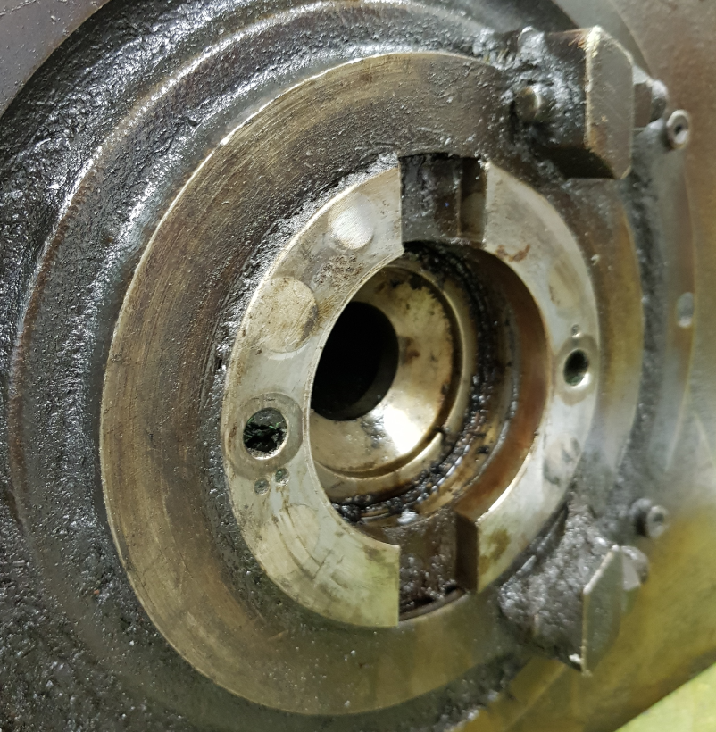
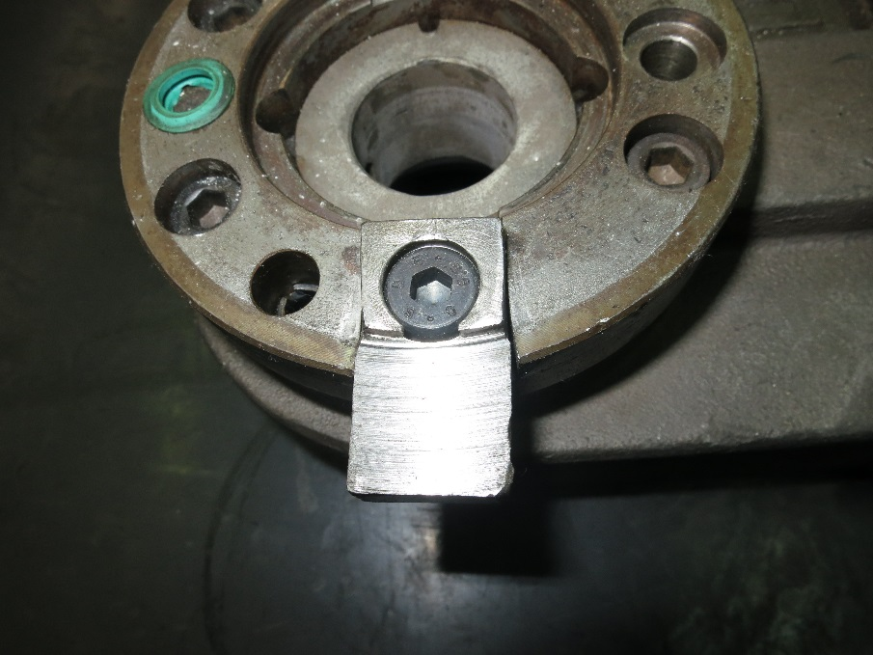
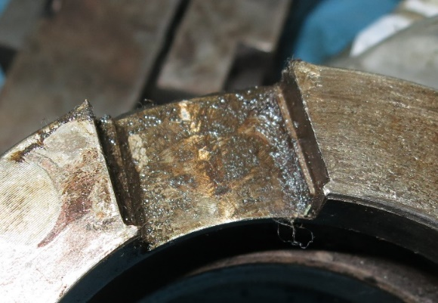
Problem
Our Solution
Damage of the weak Keys on Take-Out Arm cause backlash between Keyways on output hub and keys on Take-Out Arm. This cause damage of Gearbox
New output hub with induction hardened keyways, keys machined into Take-Out Arm adapter and end stop separated from key reduces risk to damage the gear box
Notes:
2

Slide 3
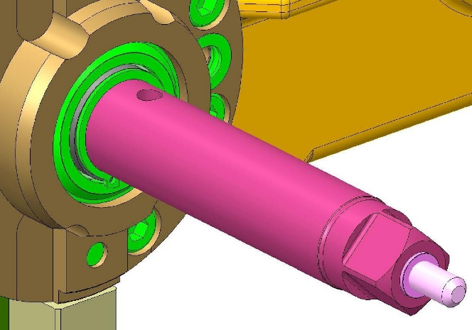
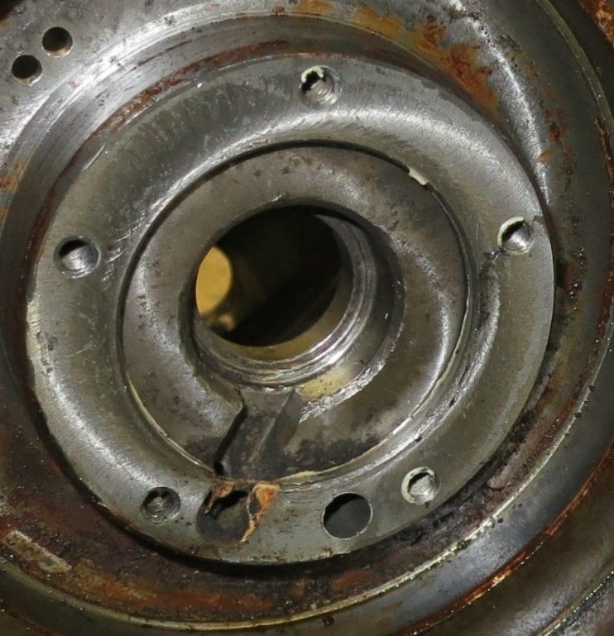
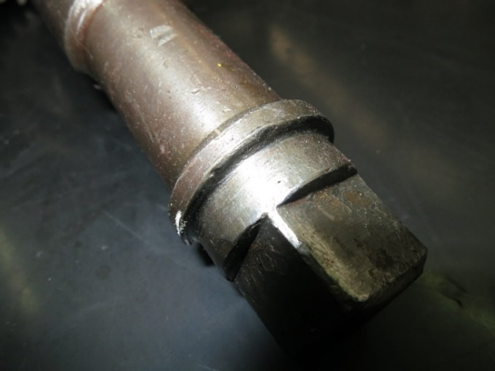
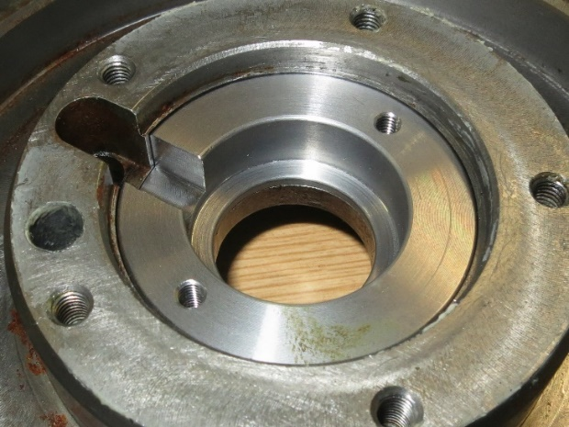
Problem
Our Solution
The position of the End-Stop of the Take-Out arm on the Gearbox housing varies on each section.
The position depends on the wear of the Gearbox housing and the wear on the Take-Out arm shaft.
The repaired gearbox has the exact Take Out arm position as with a new gearbox
Shaft of the ISE Take-Out Arm has no contact with the Gearbox housing
NO FLANGE, NO CONTACT WITH GEARBOX HOUSING
RING INSERT
WEAR ON GEARBOX HOUSING
WEAR ON FLANGE OF TAKE-OUT ARM SHAFT
REPAIRED GEARBOX HOUSING
Notes:
3

Slide 4
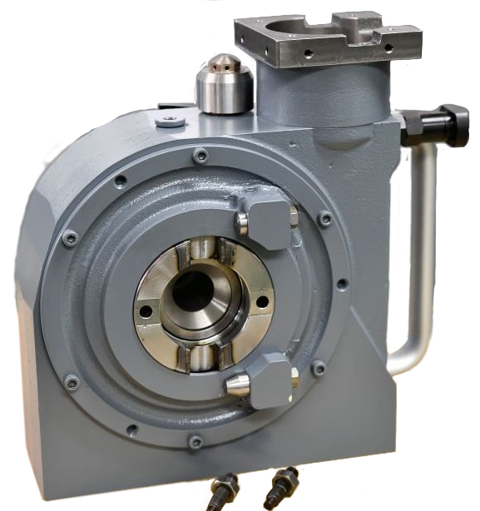
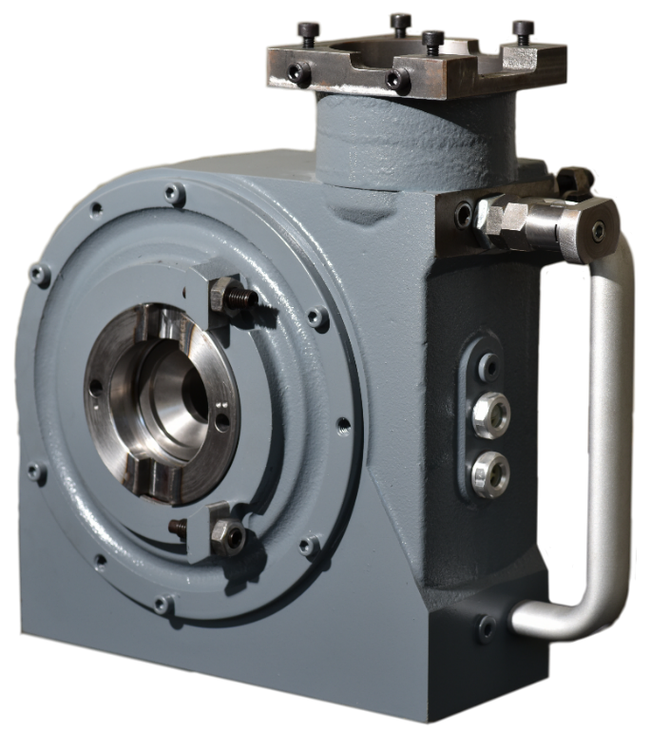
Problem
Our Solution
End Stop on Gearbox brakes when Take-Out Arm runs with high speed against End Stop.
New front cover with extra strong end stops
Notes:
4

